Slide 1
Ballet 101
“The Art of Grace”

Slide 2
Body Alignment
Alignment basically means good posture.
With good alignment, the various body parts are in correct position with one another.

Slide 3
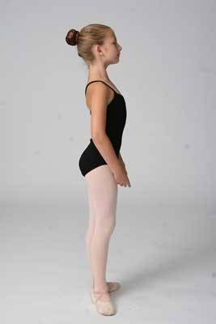
Your weight should be distributed between both feet. Keep all ten toes on the floor.
Your knees should be directly over your toes.

